Slide 1
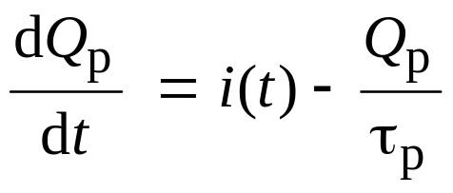
Chapter 8. Transient response
The diodes are used as switches in many applications. Of prime concern is the speed at which the pn junction diode can be made to switch from “off” to “on” state and vice versa.
For a p⁺n diode, under steady state forward biased condition, there will be an excess charge (Q_{p}) stored in the n-region. When the diode is turned off, the excess charge does not go to zero instantaneously. There are two methods by which this excess charge can decay to zero.
- By current flow (i.e, flow of charge)
- By recombination
In equation form:

Slide 2
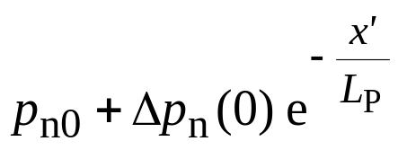
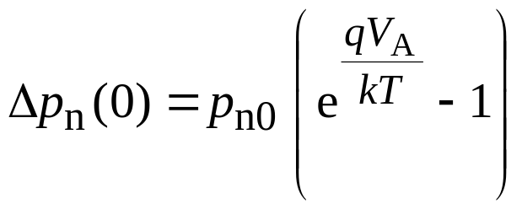
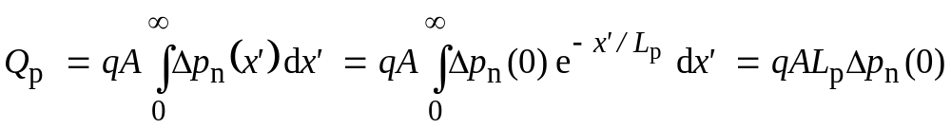
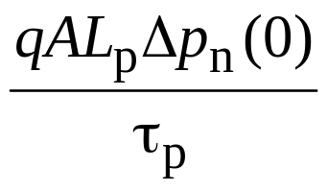
Turn-off transient
p⁺
n
x'
and
To maintain this charge, a current I = must
be supplied at x′ = 0

Slide 3
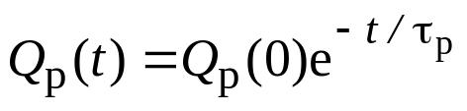
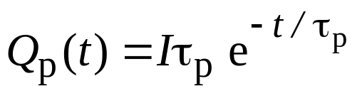

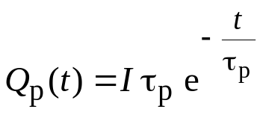
Turn-off transient with I = 0
If the current is zero,
But Q_{p} = I τ_{p} for t < 0. Therefore
Excess charge exponentially decays to zero, and this takes several lifetimes (several μs in Si)
p_{n}(x,t)
i
Slope = 0
Increasing t
t
Iτ_{p}
p_{n0}
x
t

Slide 4
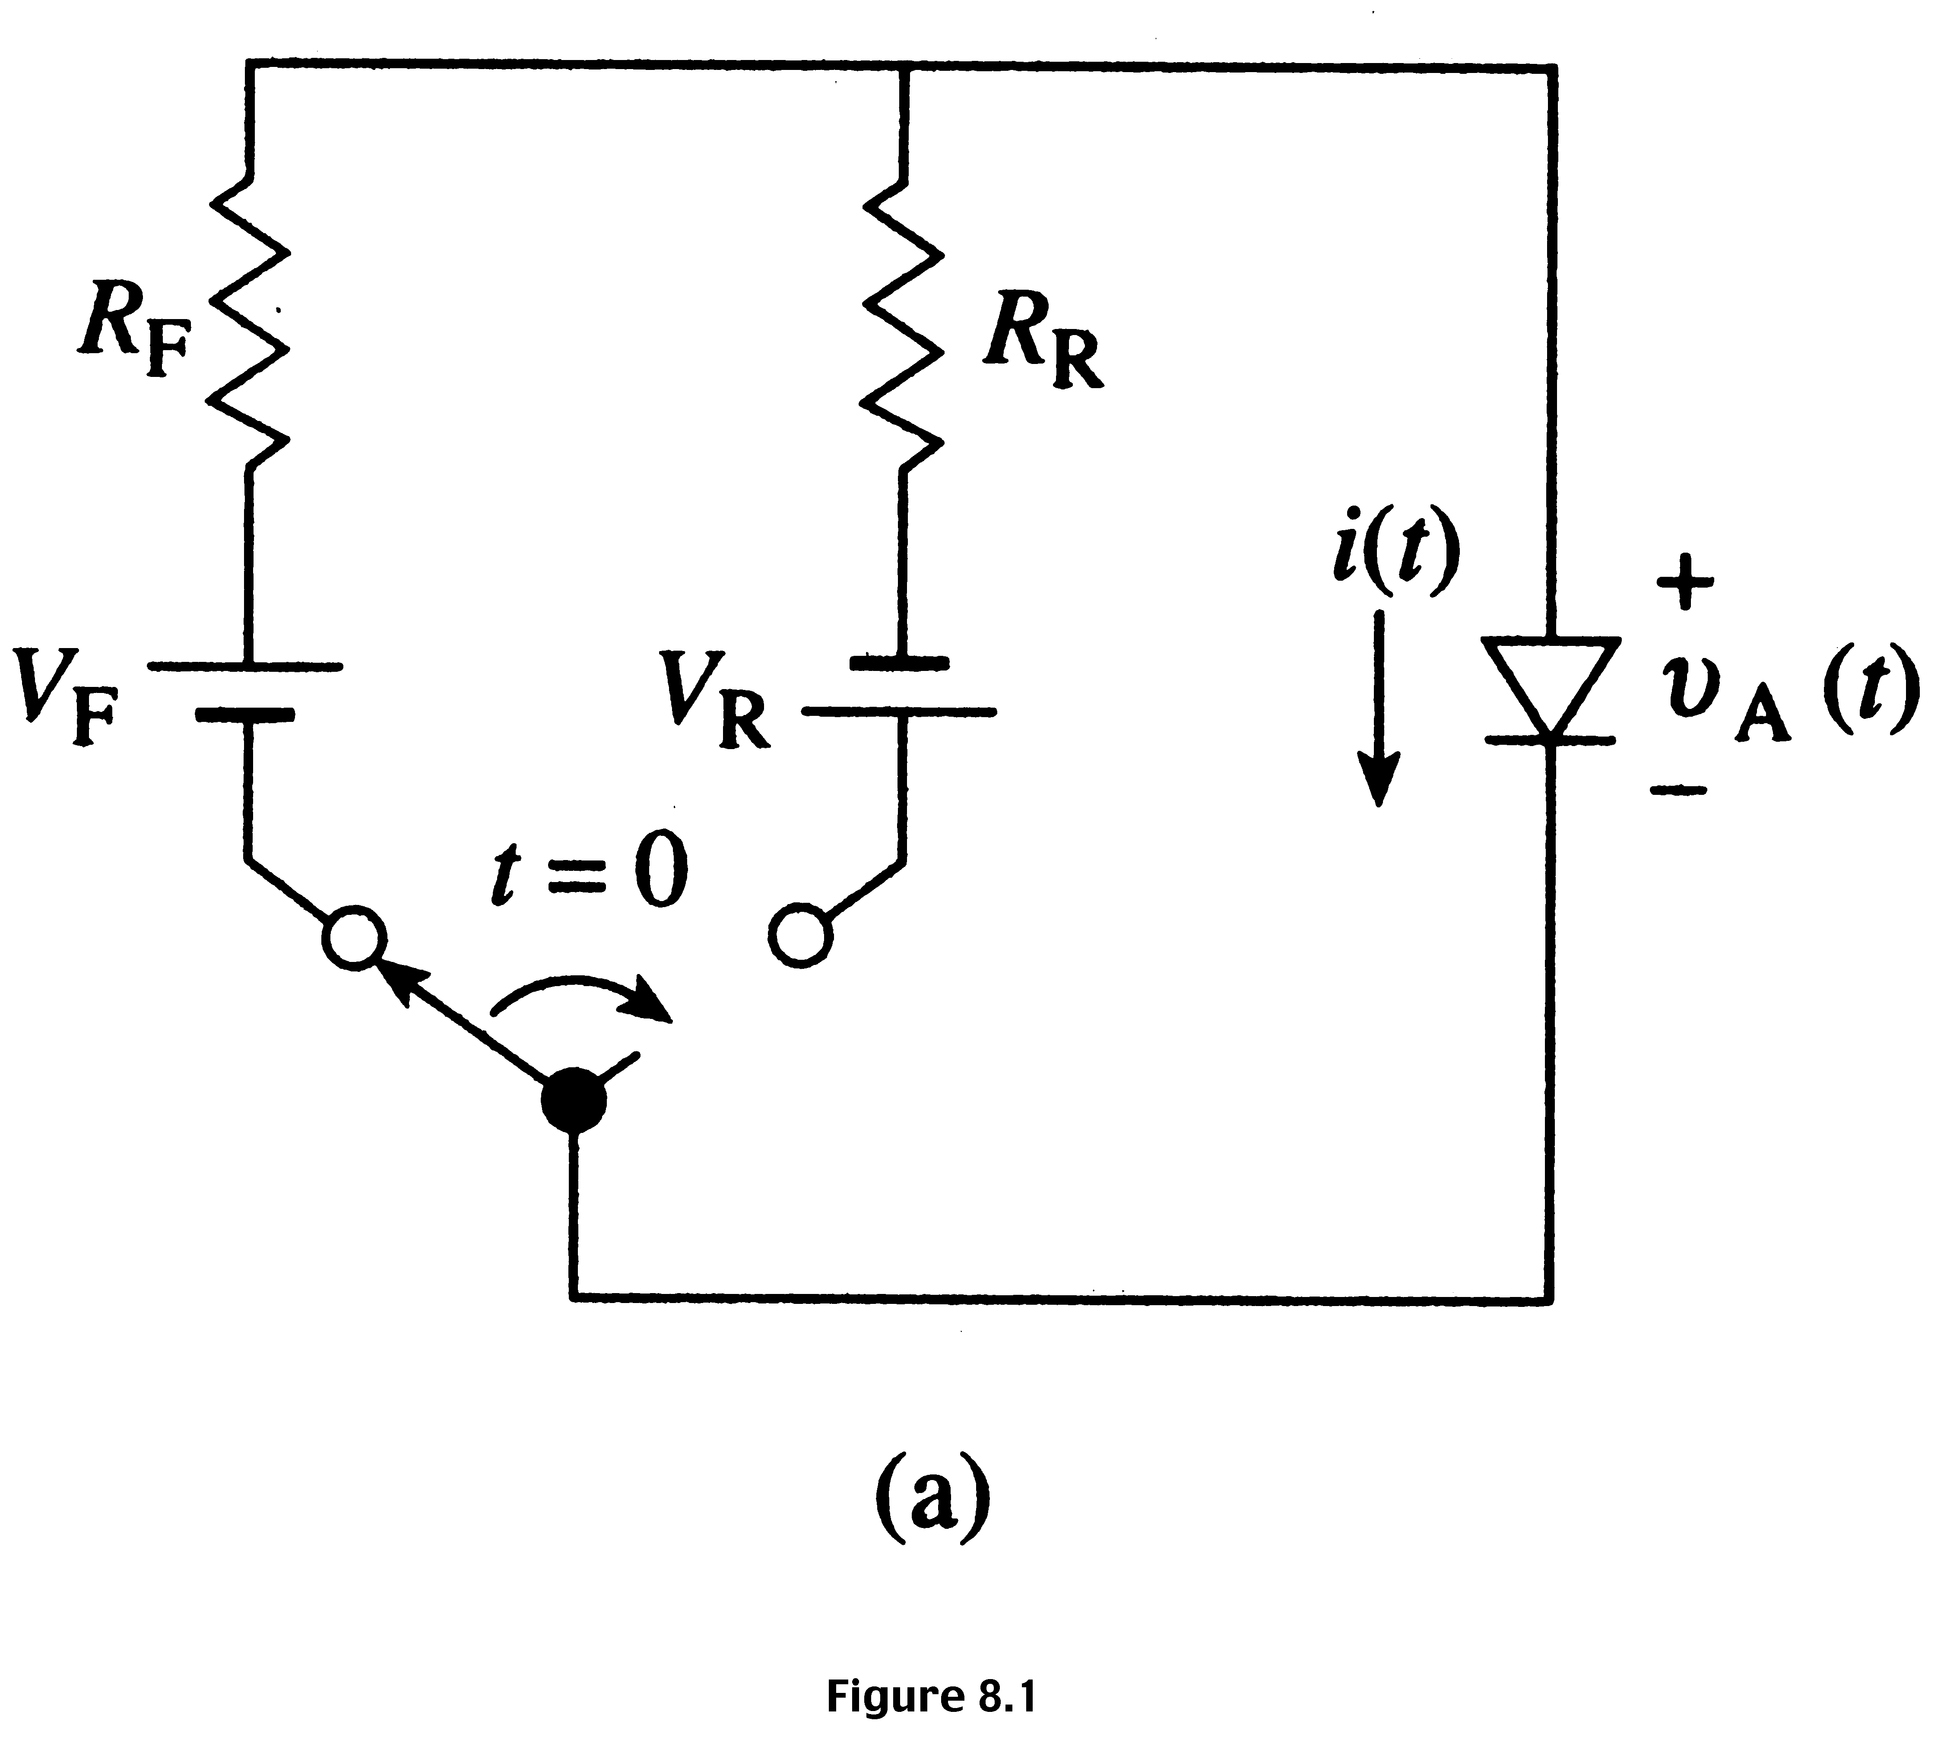
Idealized representation of a switching circuit

Slide 5
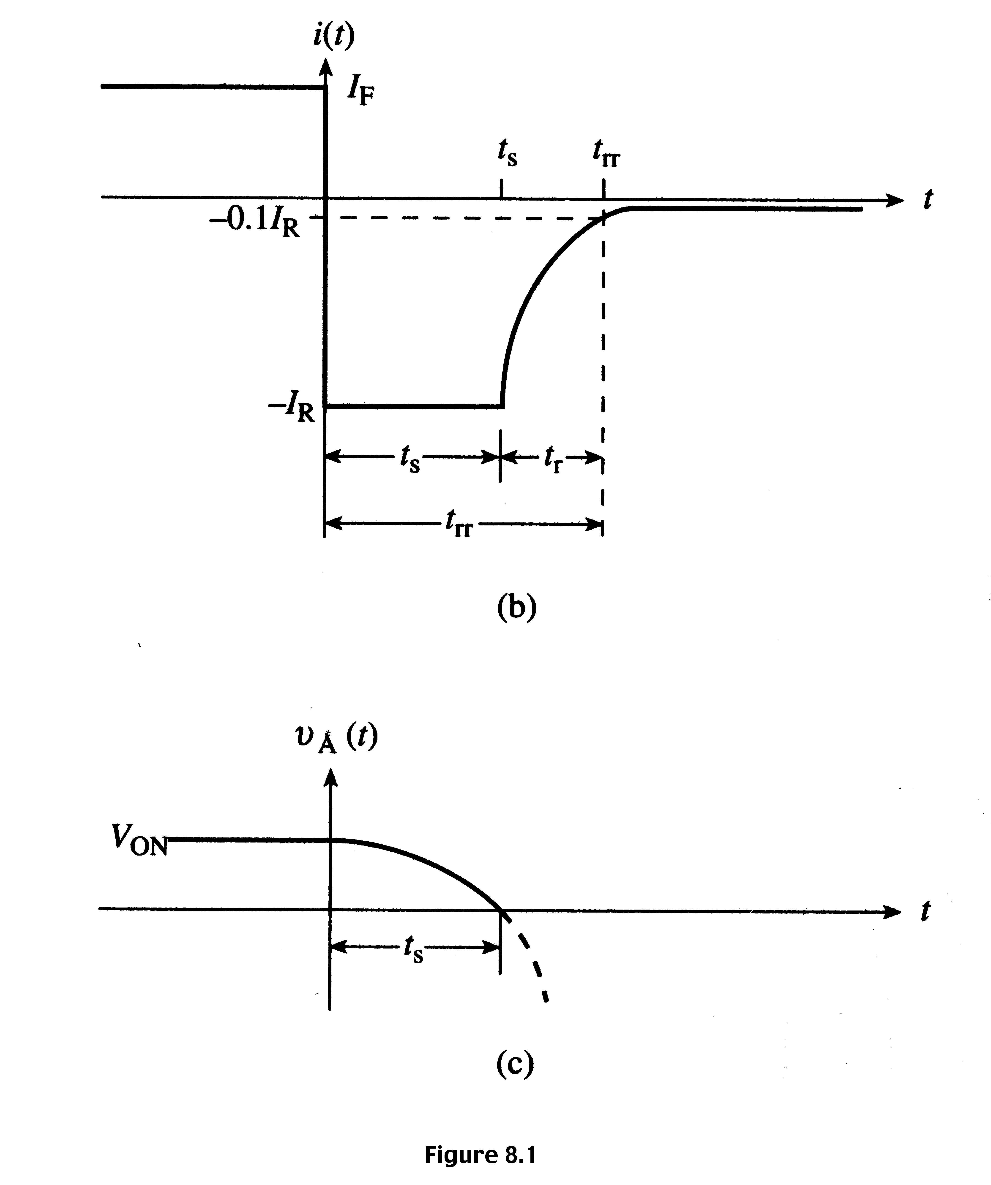
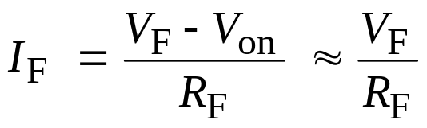
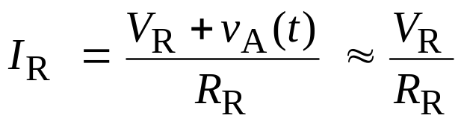
Diode current- and voltage-time transients
Note: the current does not change to I₀ (reverse saturation current), I₀, instantaneously. t_{s} is the storage time or storage delay time.

Slide 6
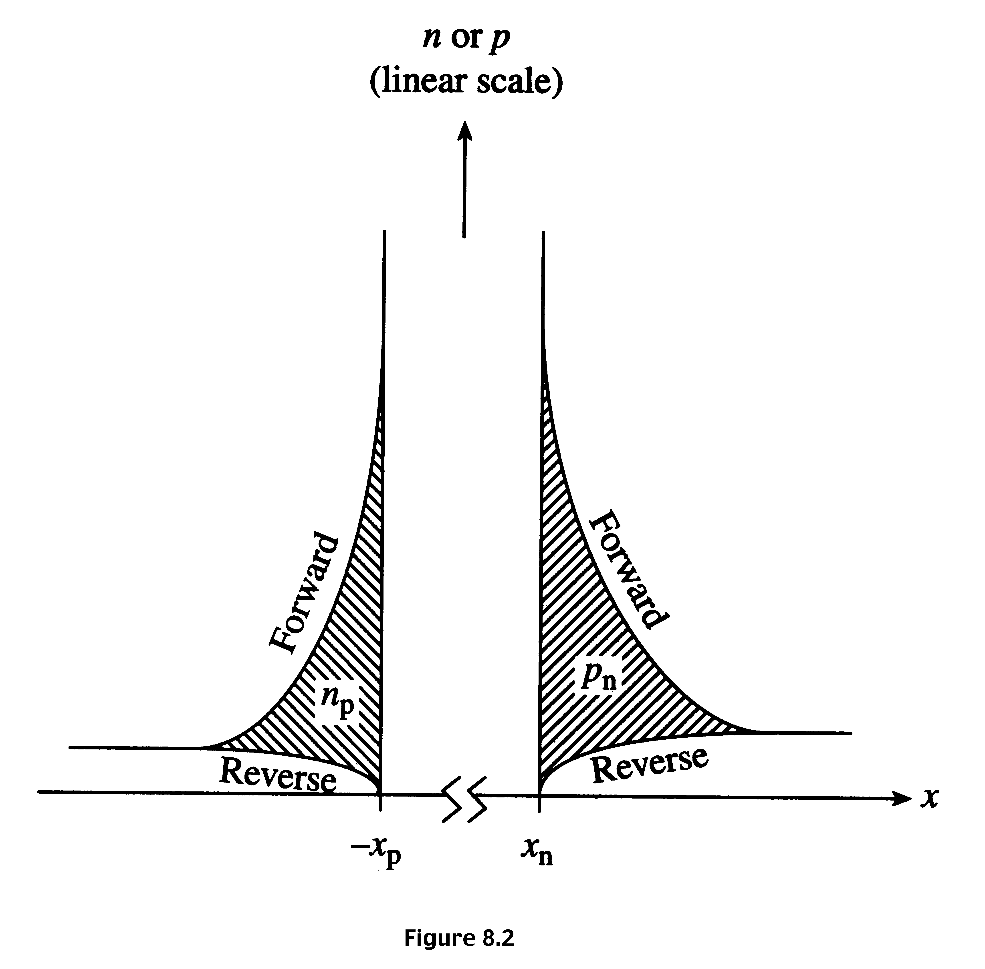
Stored minority charge causing switching delay

Slide 7
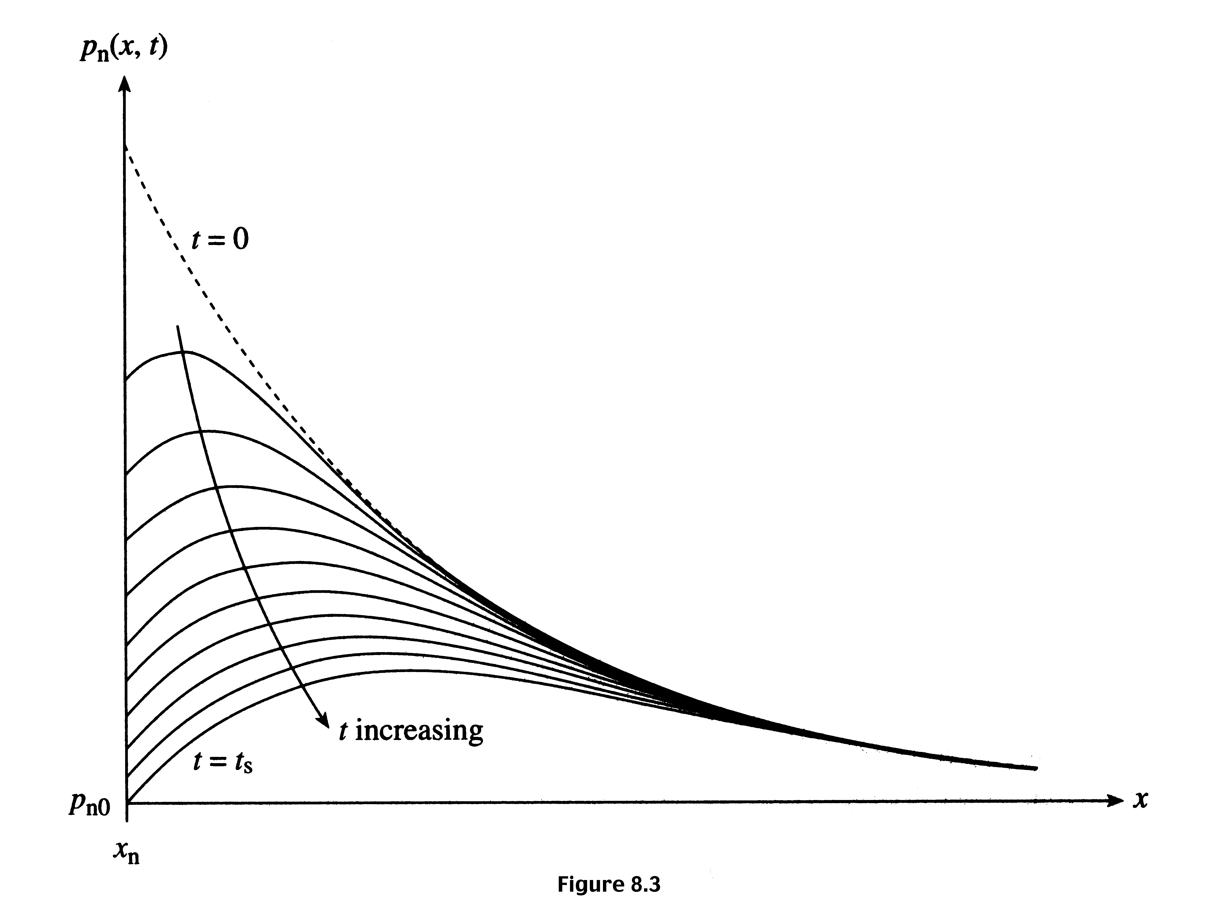
Decay of stored hole charge in a pn junction

Slide 8
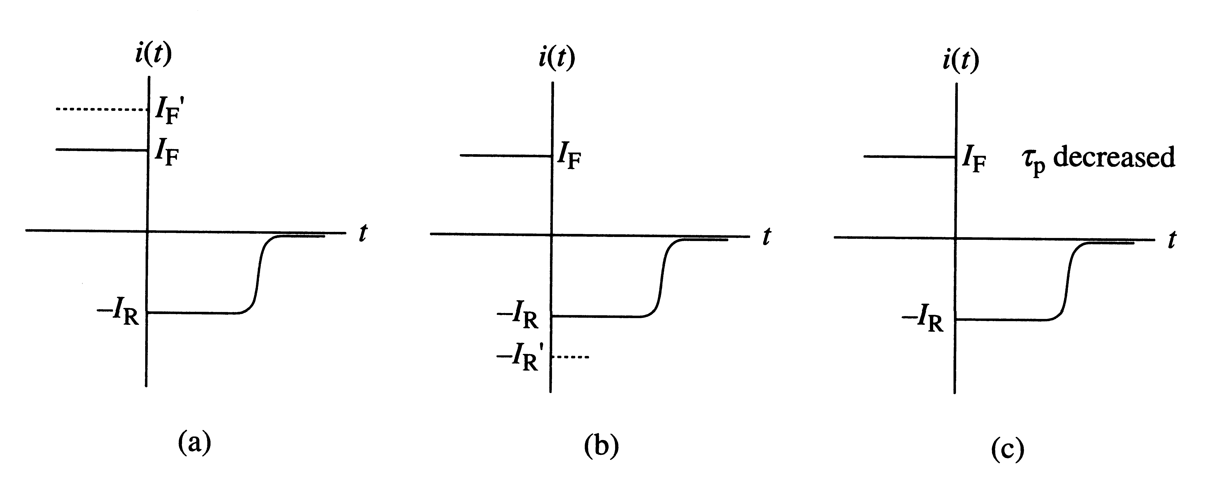
Example 1
The baseline i-versus-t transient is shown below for a diode. At t = 0, the diode is switched in reverse direction. Indicate what happens to the i-versus-t transient if:
If I_{F} is increased to I_{F}'
If I_{R} is increased to I_{R}'
(c) If τ_{p} is decreased, lifetime made shorter

Slide 9
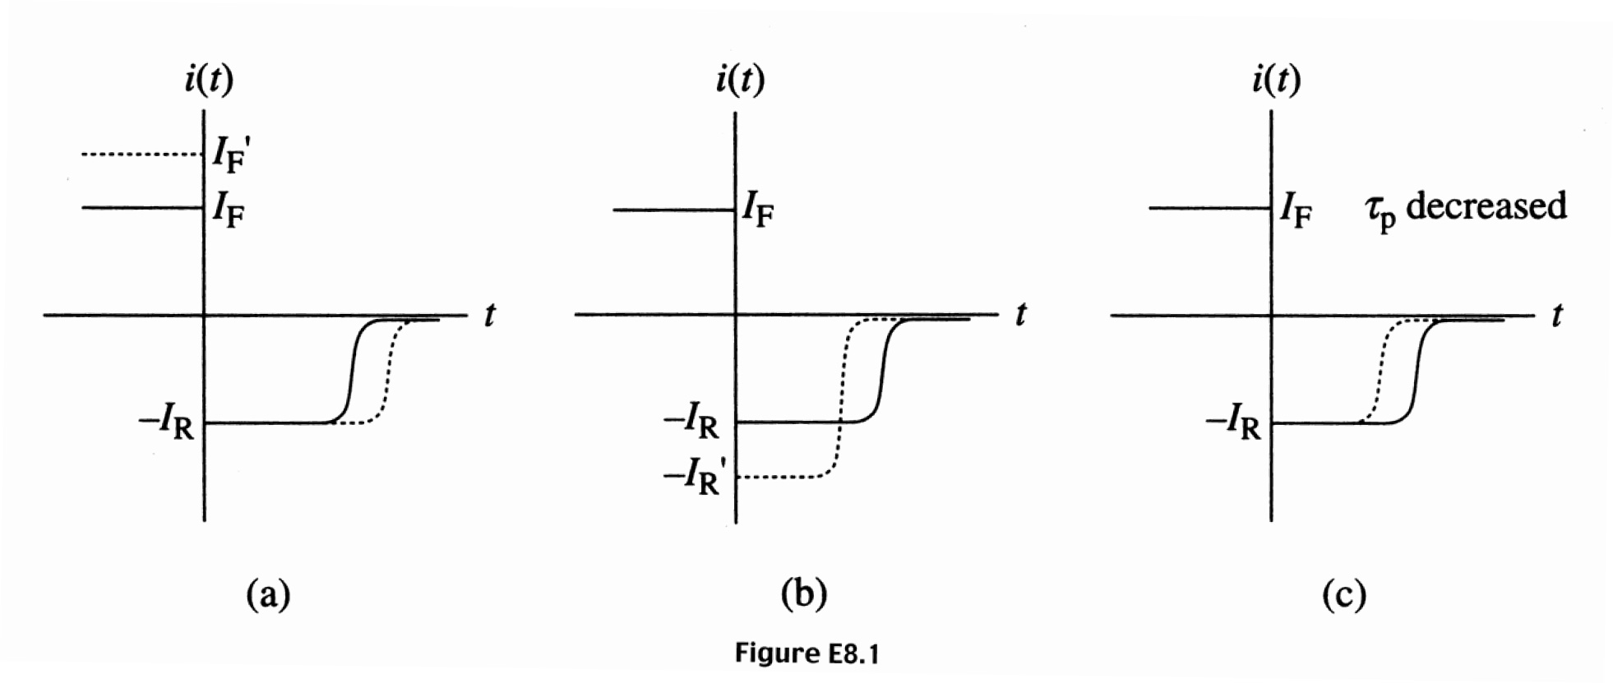
Example 1: Solution

Slide 10
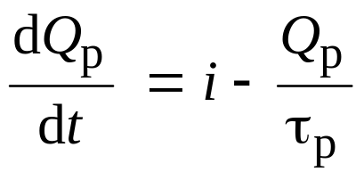
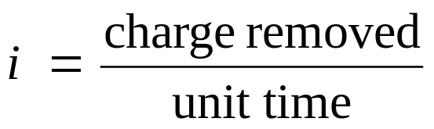
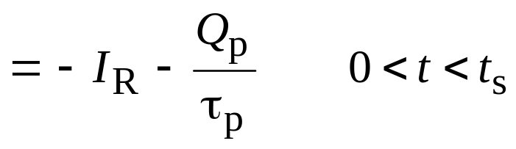
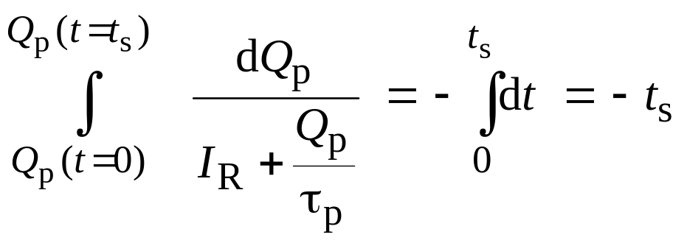
Storage delay time: Quantitative analysis
Consider a p⁺n diode.

Slide 11
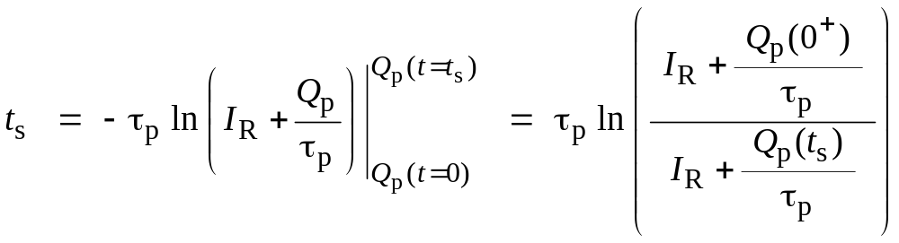
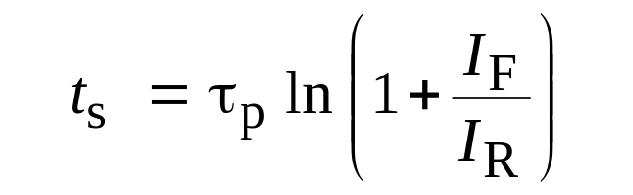
Storage delay time: Quantitative analysis
Since Q_{p}(t = 0) = I_{f} τ_{p} and if we assume that Q_{p}(t = t_{s}) ≈ 0, then
Minority carrier lifetimes can be measured using this method.

Slide 12
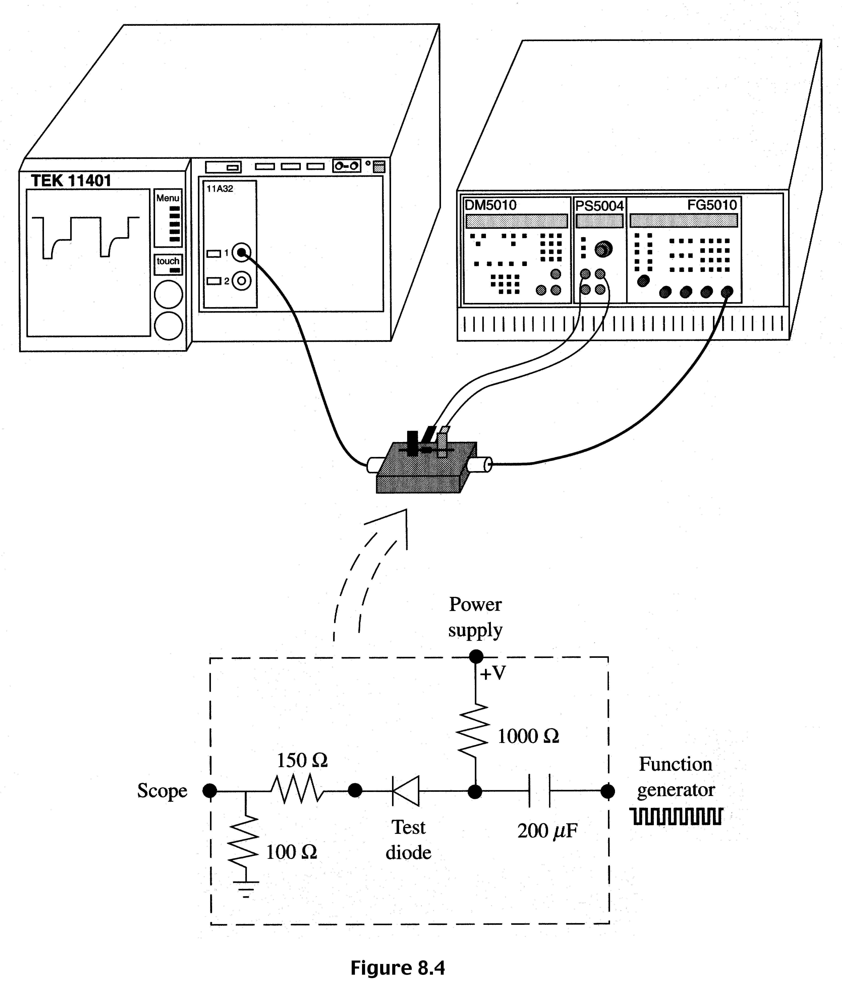
Transient response measurement system

Slide 13
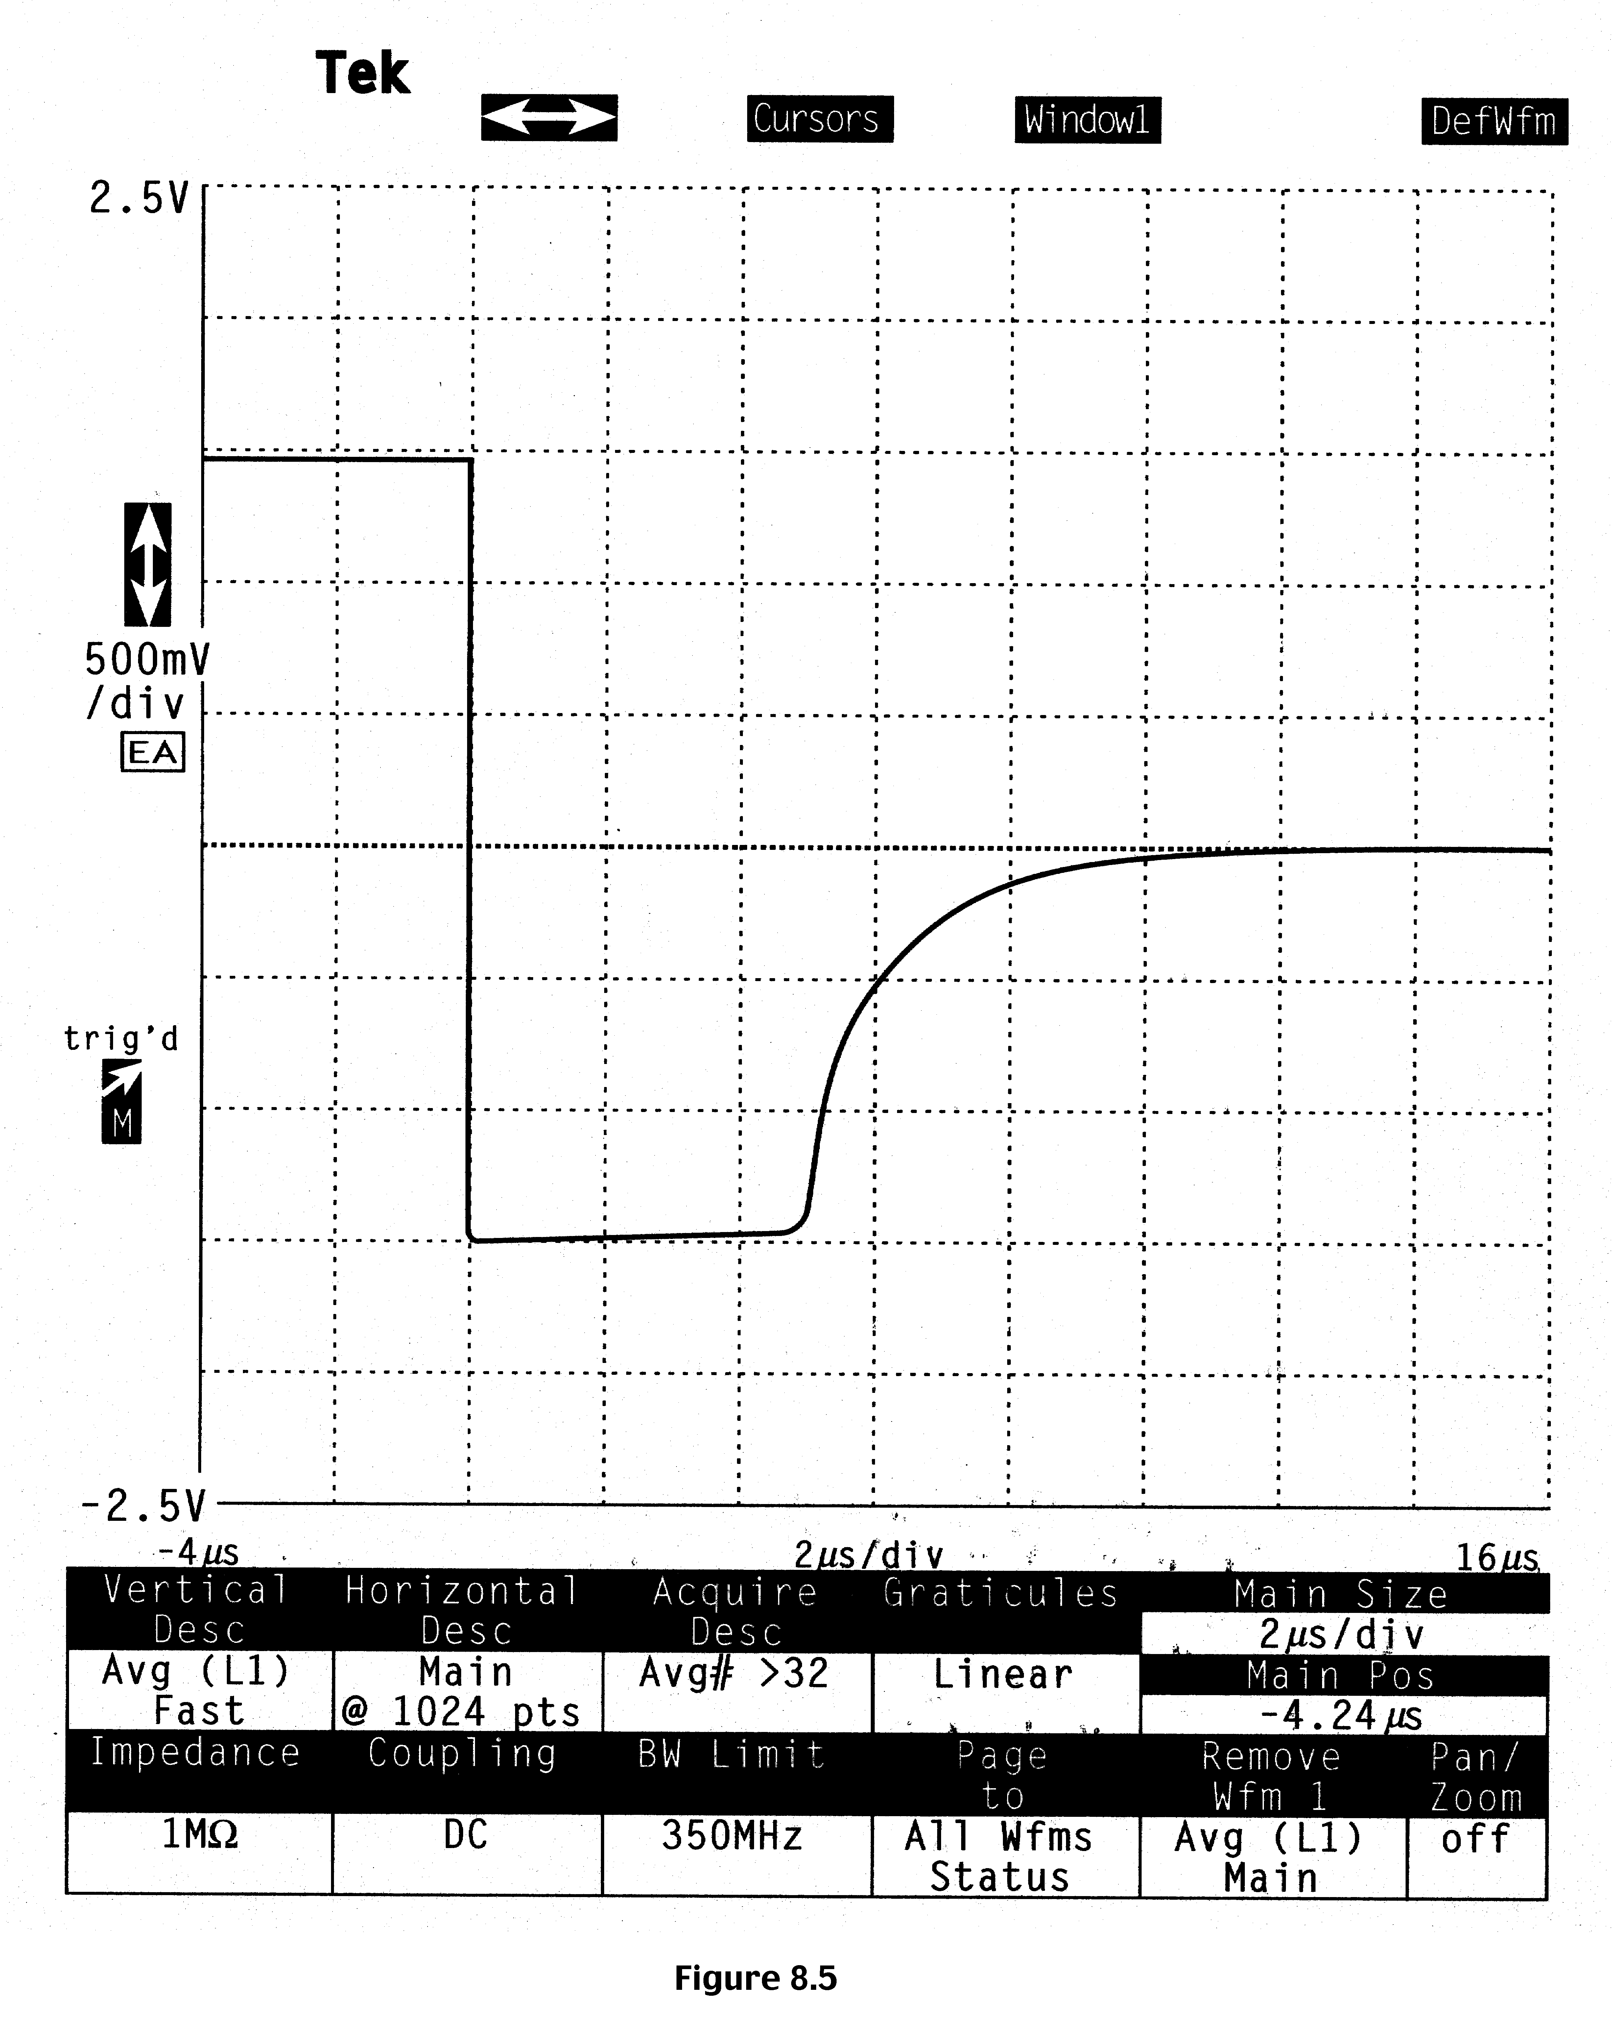
Sample current-time turn-off transient

Slide 14
Chapter 9. PN-junction diodes: Applications
Diode applications:
  Rectifiers
  Switching diodes
  Zener diodes
  Varactor diodes (Varactor = Variable reactance)
Photodiodes
  pn junction photodiodes
  p-i-n and avalanche photodiodes
Solar Cells

Slide 15
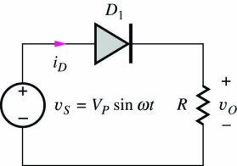
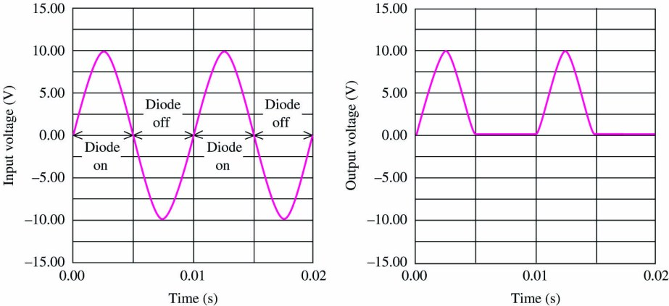
Half-Wave Rectifier Circuit with Resistive Load
For positive half-cycle of input, source forces positive current through diode, diode is on, v_{o} = v_{s}.
During negative half cycle, negative current can’t exist in diode, diode is off, current in resistor is zero and v_{o} =0 .

Slide 16
Rectifiers
Low R in forward direction:
  p⁺-n-n⁺ structure preferred
  The p⁺ and n⁺ regions reduce the parasitic resistance.
Low I₀ in reverse:
  Ge is worse than Si. Why?
High voltage breakdown in reverse:
  p⁺-n-n⁺ structure
  Higher bandgap materials preferred. Why?
I
V

Slide 17
Switching diodes
Diodes can be used as switching devices
Need to change from conducting to non-conducting at high speed
Storage time or turn-off transients should be small
Add recombination centers to reduce minority carrier lifetimes
  For example adding 10¹⁵cm^{–3} gold (Au) to Si reduces hole lifetime to 0.01 μs from 1 μs!
Use narrow-base diodes
  Amount of charge stored in the neutral region of the diode will be small.

Slide 18
Zener diodes
The breakdown characteristics of diodes can be tailored by controlling the doping concentration
Heavily doped p⁺ and n⁺ regions result in low breakdown voltage (Zener effect)
Used as reference voltage in voltage regulators
I
V
Region of
operation

Slide 19
Varactor diodes (Variable reactance diode)
Voltage-controlled capacitance of a pn junction can be used in tuning stage of a radio or TV receiver.
C_{J} ∝ (V_{A})^{–n} , where n = 1/2 for an abrupt pn junction. However, n can be made higher than 1/2 by suitably changing the doping profile.
N_{A} or N_{D}
Linearly graded
Hyper abrupt
abrupt
x

Slide 20
Opto-electronic diodes
Many of these diodes involve semiconductors other than Si. Use direct bandgap semiconductors.
Devices to convert optical energy to electrical energy
  photodetectors: generate electrical signal
  Solar cells: generate electrical power
Devices to convert electrical energy to optical energy
  light emitting diodes (LEDs)
  laser diodes

Slide 21
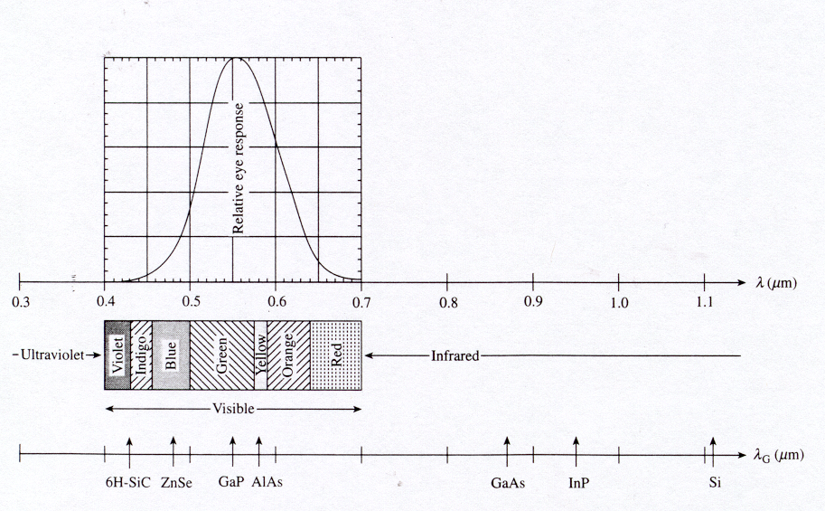
Optical spectrum correlated with relative eye sensitivity
Photon energy E_{ph} = h c / λ
Inserting numerical values for h and c yields E_{ph} = 1.24 eV μm / λ
Note: Our eye is very sensitive to green light

Slide 22
Photodiodes
Specifically designed for detector application and light penetration
I_{L} = – q A (L_{N} + W + L_{P}) G_{L} assuming uniform photo-generation rate, G_{L}
I = I_{dark} + I_{L}
I
V_{A}
I
V
P n
Increasing
light intensity
L_{n}
W
L_{p}

Slide 23
Photodiodes
If the depletion width is negligible compared to L_{n} + L_{p}, then I_{L} is proportional to light intensity.
Spectral response - an important characteristic of any photo-detector. Measures how the photocurrent, I_{L} varies with the wavelength of incident light.
Frequency response - measures how rapidly the detector can respond to a time varying optical signal. The generated minority carriers have to diffuse to the depletion region before an electrical current can be observed externally. Since diffusion is a slow process, the maximum frequency response is a few tens of MHz for pn junctions. Higher frequency response (a few GHz) can be achieved using p-i-n diodes.

Slide 24
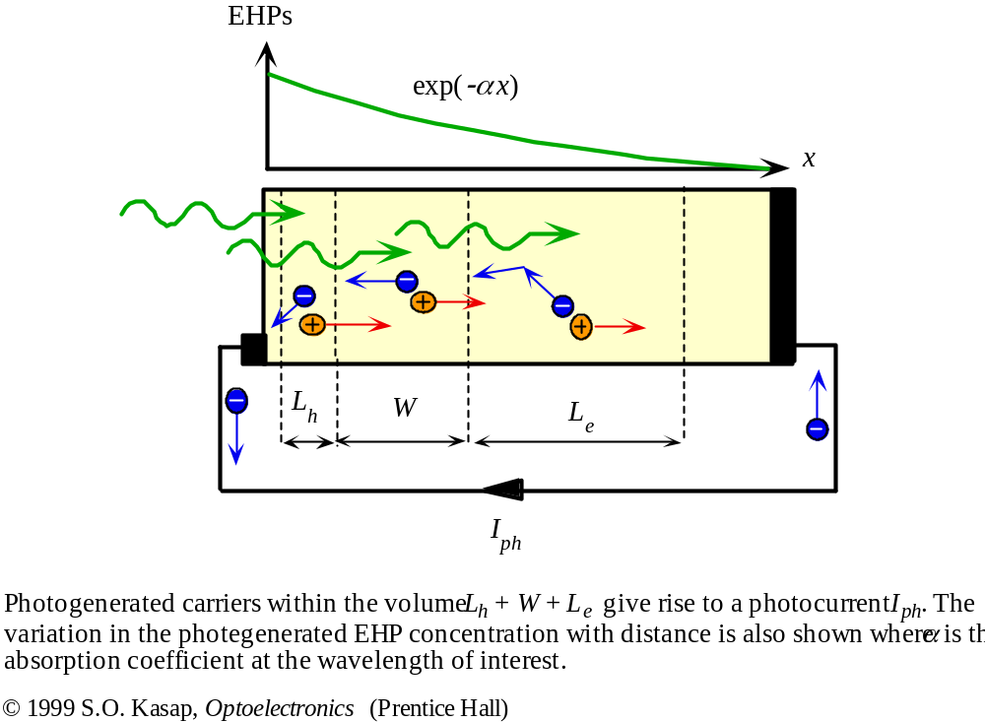
Fundamentals of Solar Cell

